Slide 1
Королева Англии
Елизавета 2

Slide 2
Биография
Елизавета II (англ. Elisabeth II, полное имя — Елизавета Александра Мария, Elisabeth Alexandra Mary; 21 апреля 1926, Лондон, Великобритания) — ныне царствующая королева Великобритании.

Slide 3
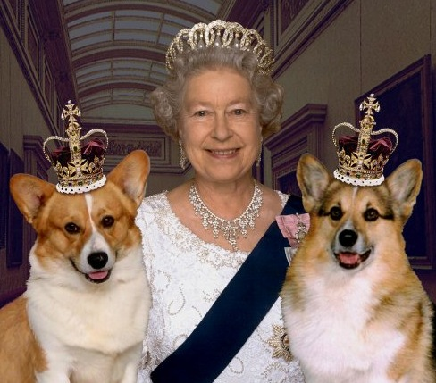

Slide 4
Elisabeth II
Occurs from the Windsor dynasty. Ascended to a throne on February 6 1952 at the age of 25 years after death of the father of king George VI. Is the British (English) monarch oldest on age in the history. Now takes the second place in the history on duration of stay on the British throne (after queen Victoria) and also the second place in the world on duration of stay in quality of the head of state among current heads of states (after the king of Thailand Pumipona Adulyadeta).

Slide 5
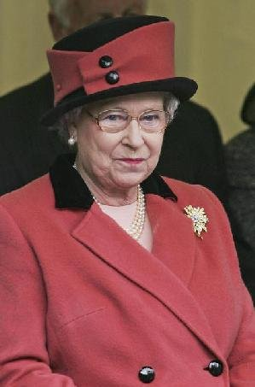
Is the head of the British Commonwealth of the nations and, besides Great Britain, the queen of 15 independent states: Australia, Antigua and Barbuda, the Bahamas, Barbados, Belize, Grenada, Canada, New Zealand, Papua — New Guinea, Saint Vincent and Grenadines, Saint-Keats and Nevis, Saint Lucia, the Solomon Islands, Tuvalu, Jamaica.

Slide 6
Is also the head of Anglican church and the Supreme Commander the British armed forces.

Slide 7
Уouth
Oldest daughter of prince Albert, duke of York (future king George VI, 1895 — 1952) and ladies Elizabeth Boaz-Lyon (1900 — 2002). Her grandfathers and grandmother: on the father - king George V (1865 — 1936) and queen Maria (1867 — 1953), the princess Teksky; on mother - Claude George Boaz-Lyon (1855 — 1944), count Stratmor and Cecilia Nina Boaz-Lyon .Princess Elizabeth Alexander Maria was born in the London area Meyfer in the residence the column Stratmor on Bryuton Street, the house No. 17. Now the area is reconstructed, and the house more doesn't exist, but on this place the memorial board [1] is established. The name was received in honor of mother (Elizabeth), grandmothers (Maria) and the great-grandmother (Alexander). 1961).

Slide 8
Elizabeth got good house education, generally a humanitarian orientation. In the childhood it was very inquisitive, contemporaries noted her mind, good manners and royal advantage. Since young years Elizabeth was interested in horses and was engaged in riding. To this hobby it is true many decades.

Slide 9
Elizabeth…
At the birth Elizabeth became the duchess York and was the third in the line of inheritance of a throne after the uncle Edward, the prince Welsh (future king Edward VIII) and the father. As prince Edward was rather young and as was considered, should marry and get children, initially Elizabeth wasn't considered as the real candidate for a kingdom. However Edward was compelled to abdicate literally some months later after George's V death in 1936. Prince Albert (George VI) became the king, and 10-year-old Elizabeth became the successor of a throne and moved with parents from Kensington in the Buckingham palace. Thus it remained as "heir presumptive" ("the alleged successor"), and in case of the birth from George VI the son a throne would be inherited by it.

Slide 10
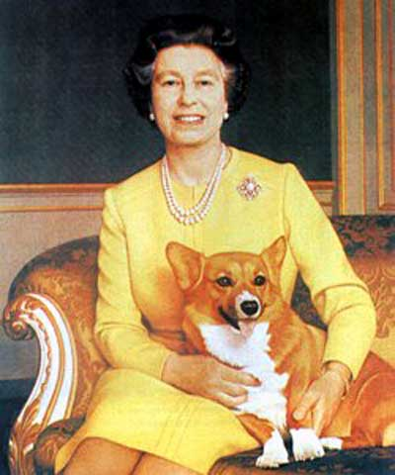

Slide 11
The Second World War began, when Elizabeth was 13 years old. On October 13 1940 it broadcast for the first time - the address to children, affected by disasters of war [1]. In 1943 its first independent emergence on public - visit to a regiment of Guards grenadiers took place. In 1944 it became one of five "the state advisers" (the persons having the right of performance of functions of the king in case of his absence or incapacity). In February 1945 Elizabeth entered "Auxiliary territorial service" - female groups of self-defense - and has training preparation as the mechanic-driver of the ambulance.
In 1947 Elizabeth accompanied parents on a trip across South Africa and in day of the 21 anniversary broadcast the solemn promise to devote the life to service of the British Empire.
The same year 21-year-old Elizabeth married 26-year-old Philippe Mauntbatten - the officer of the British fleet, the member of the Greek and Danish royal families and the great-great-grandson of queen Victoria. They got acquainted for the first time in 1934, and fell in love with each other, as it is considered, after visit of naval college by Elizabeth in Dartmouth where Philippe, in the 1939th studied. Having become the spouse of the princess, Philippe received a title of the duke Edinburgh.

Slide 12
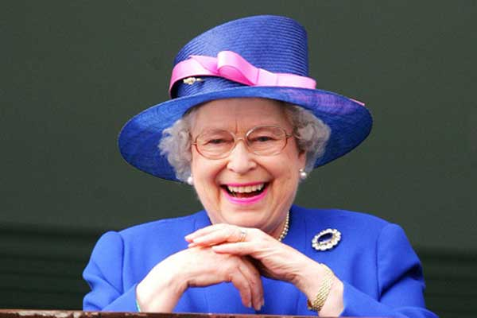

Slide 13
In 1948 at Elizabeth and Philippe son Charles (Charles), in 1950 - daughter Anna was born.

Slide 14
King George VI died on February 6 1952. Elizabeth who was together with the husband on vacation in K enya, was proclaimed by the queen. Ceremony of crowning of Elizabeth II took place in Westminster abbey on June 2 1953. It was the first crowning of the British monarch broadcast on television, and as it is considered, this event considerably promoted growth of popularity of telecasting.

Slide 15
On November 20, 1947 Elizabeth married lieutenant Philippe Mauntbatten (a sort. On June 10 1921), the son of the Greek prince Andrey who received a title of the duke Edinburgh.
In their family was born four children:
prince Charles (Charles Philippe Arthur George) (sort. On November 14 1948), prince Welsh;
princess Anna (Anna Elizabeth Alice Louise) (sort. On August 15 1950), carries a title "Royal princess" ("Princess Royal");
prince Andrew (Andrew Albert Christian Edward) (sort. On February 19 1960), duke of York;
prince Edward (Edward Anthony Richard Luis]] (sort. On March 10 1964), columns Uesseksky.

Slide 16
Family of Elizabet2

Slide 17
Elizabeth with the husband.

Slide 18
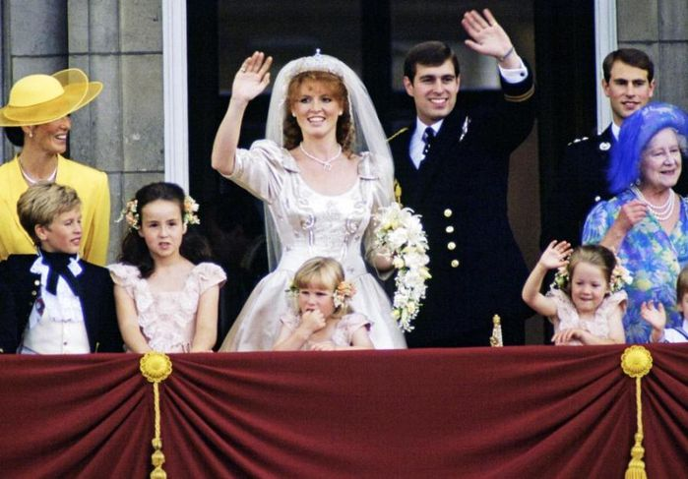
family

Slide 19
Elizabeth different in the bosom of the family and in a circle of friends, together with on a throne.

Slide 20
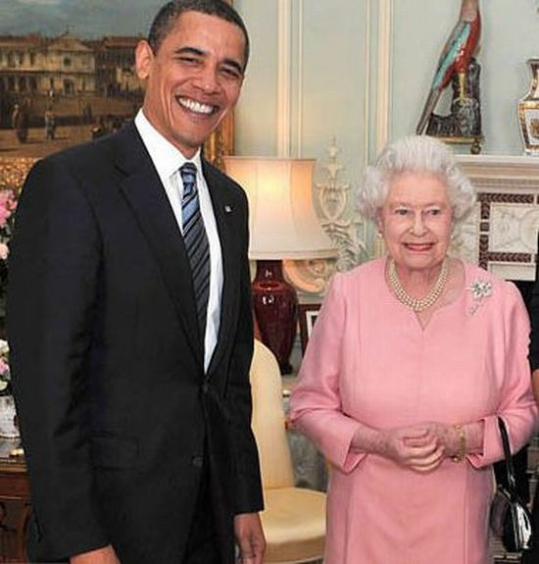

Slide 21
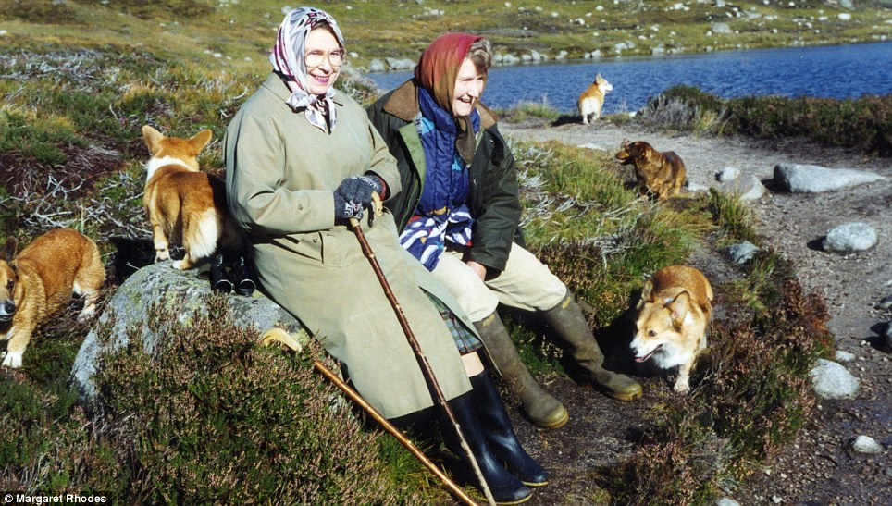

Slide 22
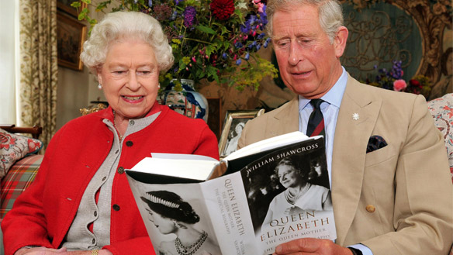

Slide 23
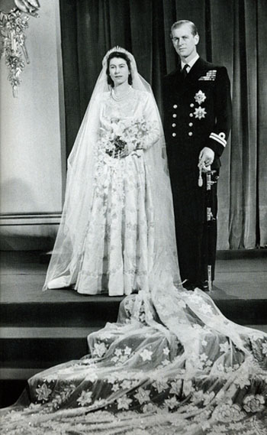

Slide 24
here what queen at us remarkable!

Slide 25
bye!

